Slide 1
Scholarsphere
Aswin Tony Kanikairaj

Slide 2
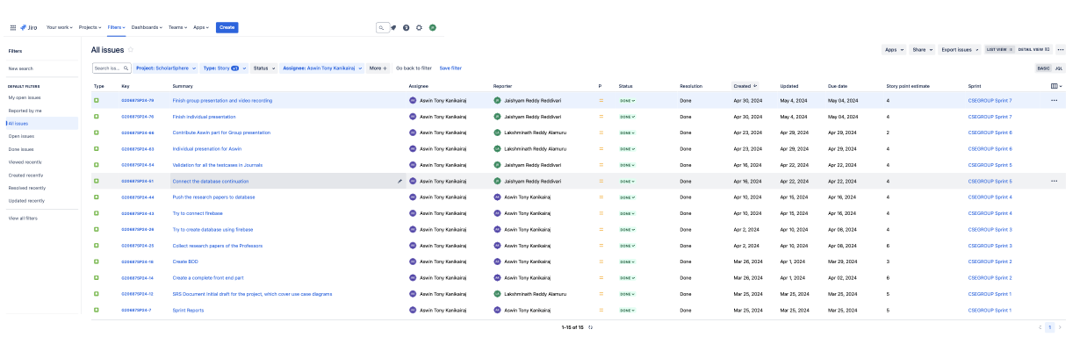
Stories

Slide 3
Sprint Overview
Sprint | Number of stories closed | Number of stories rolled over | Story points
Sprint 1 | 3 | 0 | 16
Sprint 2 | 2 | 0 | 9
Sprint 3 | 2 | 0 | 10
Sprint 4 | 2 | 0 | 8
Sprint 5 | 2 | 0 | 8
Sprint 6 | 2 | 0 | 6
Sprint 7 | 2 | 0 | 8
The average number of closed stories per sprint are 2.14.
The average number of stories rolled over are 0.
The total number of story points that I have logged are 65.

Slide 4
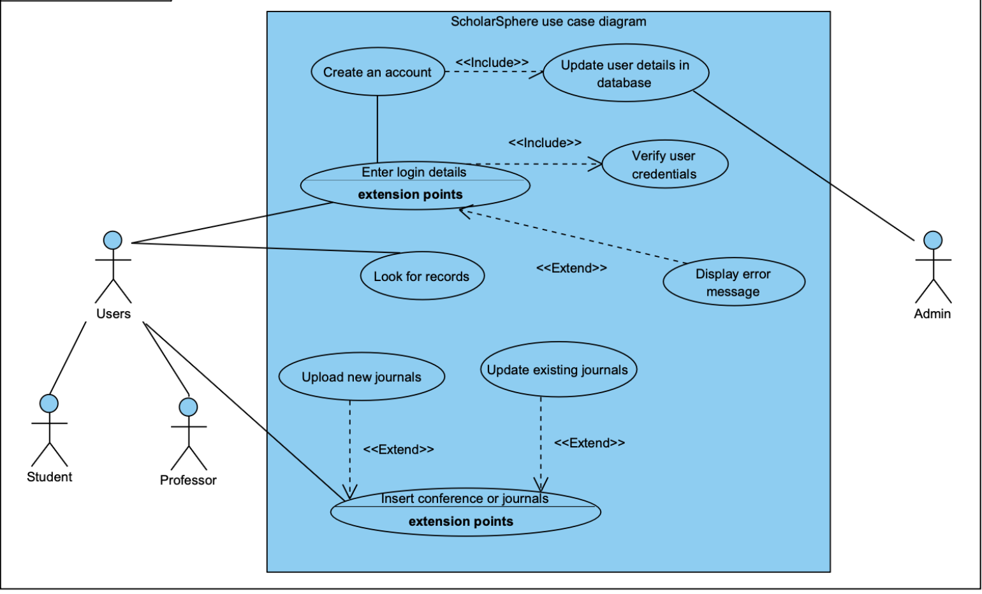
Use Cases

Slide 5
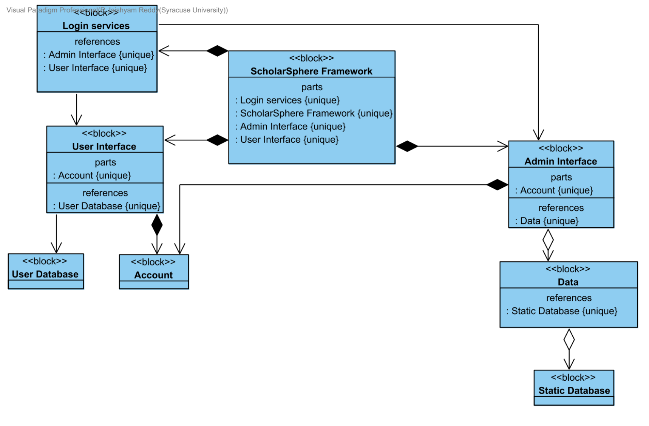
Block Definition Diagram

Slide 6


Webpage Front end

Slide 7
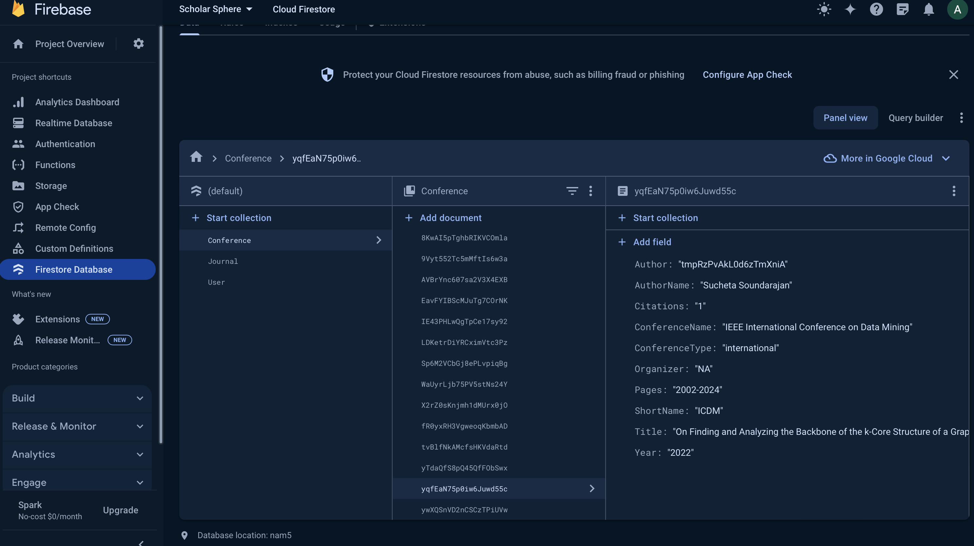
Firebase Database

Slide 8

Journal Test cases

Slide 9

Journal Test cases

Slide 10
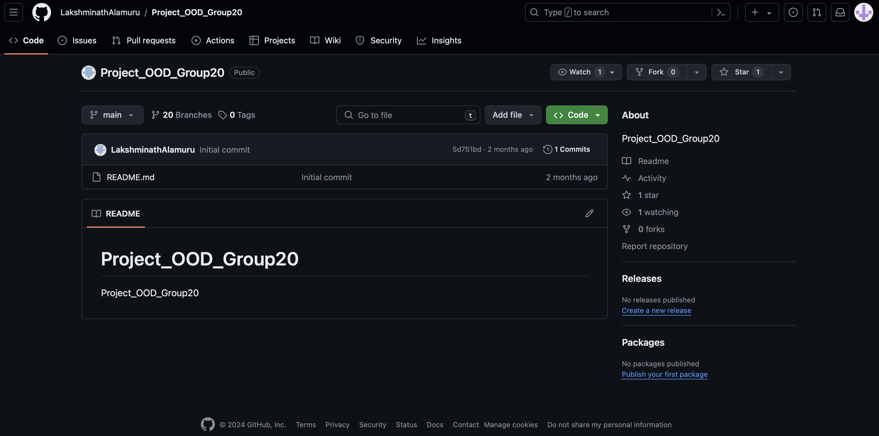
GitHub Links
Use Cases
Block Definition Diagram
Firebase Database
Journal Test Cases
Webpage Front end
Jira Account

Slide 11
THANK YOU

